Slide 1
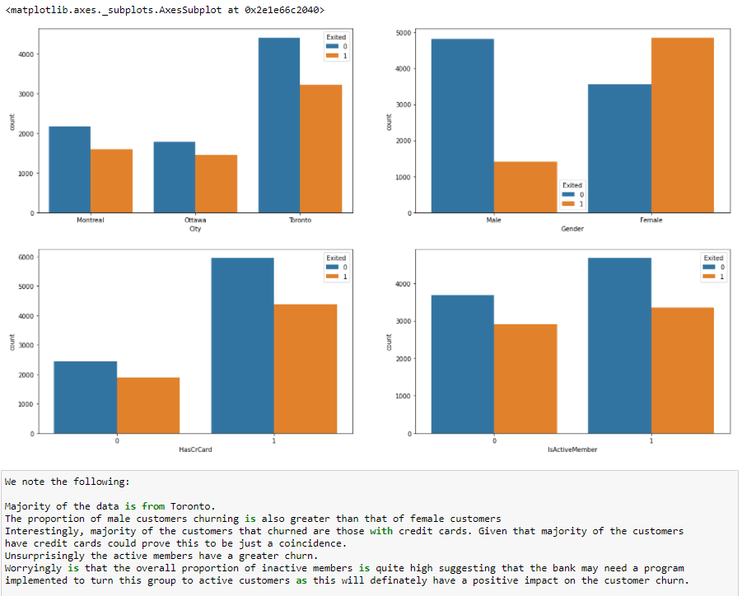
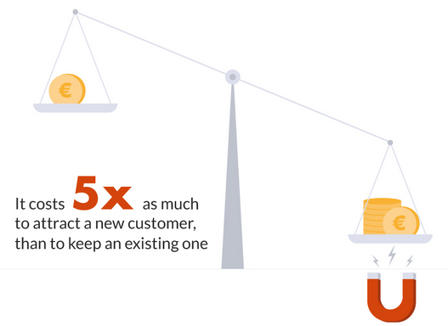
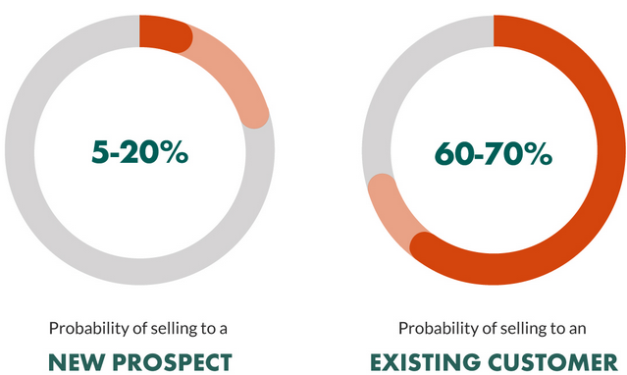
Companies lose $1.6 trillion per year due to customer churn!
And according to the Forrester, it costs 5 TIMES MORE to acquire new customers than it does to keep an existing one.
It will cost you 16 times more to bring a new customer up to the same level as an existing customer.
The second reason lies in the fact that the more customers a business retains, the more revenue it makes!
For example, the Harvard Business School Report claims that on average, a 5% increase in customer retention rates results in 25% – 95% increase of profits. And the lion’s share – 65% of a company’s business comes from existing customers!
The same truths are revealed by KPMG, who found that customer retention is the main driver of a company’s revenue.
According to Gartner, a staggering 80% of a company’s future revenue will come from just 20% of its existing customers. Meanwhile, Marketing Metrics claims that the probability of selling product to an existing customer is 60-70%, and only 5-20% to sell to a new customer.
Based on prediction with high accuracy model up to 82%, with statistically significant result. We can offer promotion to valuable customer and retain them, which can eventually give profit to bank.
From analyzing the model, we can focus on the areas where we can advertise more on offers, educate them on investment plans and communicate more frequently so that we can retain potential customers

